Slide 1
Cab Business Case Study
Help XYZ Private Equity firm in identifying the right company for investment
Sudeshna Nag

Slide 2
Agenda
Executive Summary
The problem
The approach
Overview of the Cab market in the US
Analysis
Hypothesis Test
Analysis Summary
Insights & Recommendation
Cab Business Case Study

Slide 3
Executive Summary
Generated actionable insights to help XYZ, Private equity firm in identifying the right Cab company for making investment
Understood the data provided and taking an overall look at the cab industry in the US - very lucrative market, an ever growing and ever changing in the world of digital technology
Performed exploratory data analysis and performing some hypothesis tests to recommend XYZ about the target company for investment
Analyzed the data to find trends supporting Yellow cabs as the better investment due to factors like high profitability, customer share, customer share city-wise, gender-wise customer share, monthly and yearly transactions
Hypothesis tests shows a difference in margins generated gender-wise and age group for Yellow cabs without affecting their overall profitability

Slide 4
The problem
Company
Context
Problem statement
XYZ is a private equity firm in US. XYZ is interested in using our actionable insights to help them identify the right company to make their investment.
Due to remarkable growth in the Cab Industry in last few years and multiple key players in the market, it is planning for an investment in Cab industry.
Provide actionable insights to help XYZ firm in identifying the right company for making investment.

Slide 5
The approach
Get Data
Understand Data
Analysis and Hypothesis Testing
Dataset
Provided with 4 individual data sets that contains information on 2 cab companies
Each file (data set) provided represents different aspects of the customer profile.
Datasets which are provided for the analysis:
Cab_Data.csv - transaction details for 2 cab companies
Customer_ID.csv - mapping table which links the customer’s demographic details
Transaction_ID.csv - maps transaction to customer and payment mode
City.csv - US cities, their population and number of cab users
Identify the right company for investment
By deep diving into the data and performing exploratory data analysis and performing some hypothesis tests to recommend XYZ about the target company for investment

Slide 6
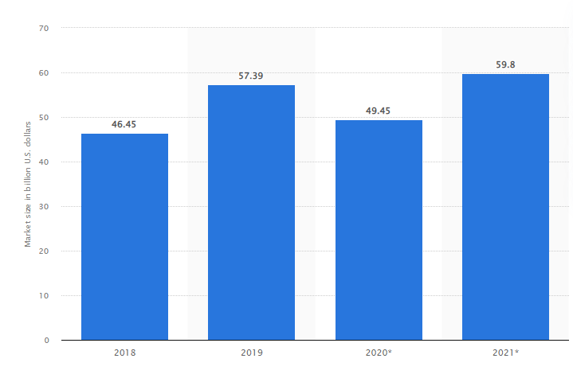
Overview of the Cab market in the US
In 2020, the total market size of taxi and limousine services in the United States reached 49.45 billion U.S. dollars.
It is believed to increase in the upcoming years due to the digitization of cab companies and modern tech advancements for better services.
Source: Statista https://www.statista.com/statistics/1174077/taxi-limousine-services-market-size-us/

Slide 7
Analysis
Understand Data - Information summary of the datasets
Data Preparation - Data Cleaning, Null Treatment, Outlier detection and removal
Perform EDA - Explore the data by appropriate visualizations
Findings from data to insights generation
Hypothesis Test - Perform some hypothesis tests on data to answer underlying questions

Slide 8
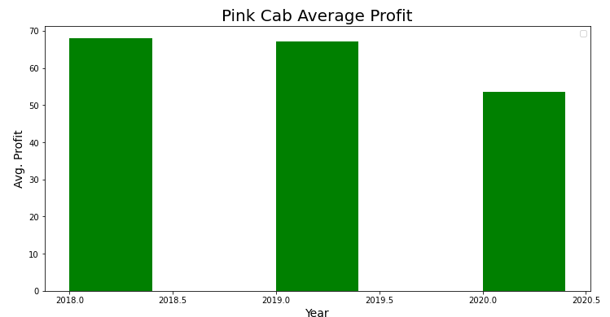
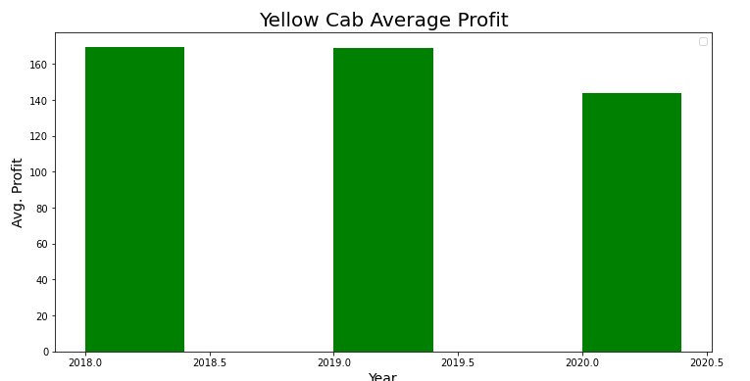
Comparing Average Profit Margin per year for Cabs
Profit margin = Price Charged - Cost of Trip
Yellow cab has a higher yearly average profit margin than Pink cab

Slide 9
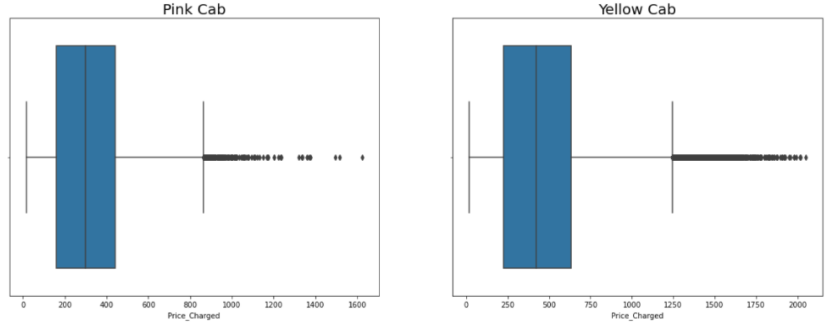
Distribution of Price Charged
The Price Charge range for Yellow cab is more than the Pink cab
Outliers could be due to use of high-end cars(not removing the outliers as these data points could be generating revenue)

Slide 10
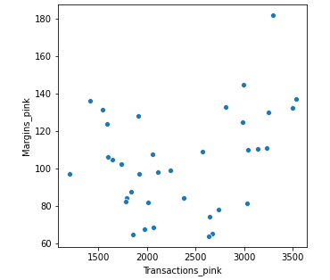
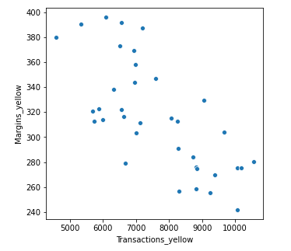
Profit generated by Transaction
Pink Cabs - Increase in profits with increase in number of transactions
Yellow Cabs - Decrease in profits with the increase in transactions

Slide 11
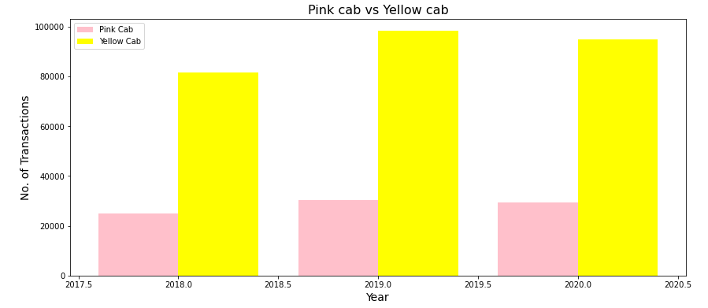
Yearly transactions
We find yearly number of transactions for Yellow cab is higher than Pink cab

Slide 12
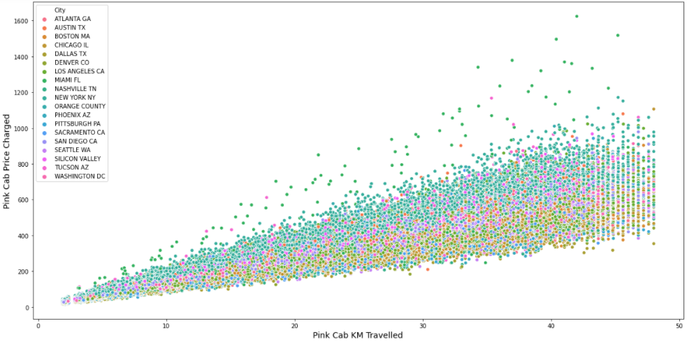
Pink Cab: Price Charged per KM per City
All the cities have the same increase in price charge with increase in distance

Slide 13
Yellow Cab: Price Charged per KM per City
Price charged by Yellow Cab in New York City is more than the other cities

Slide 14
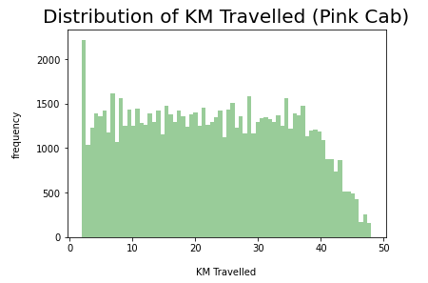
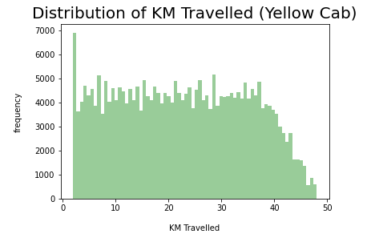
Distance range and frequency
Distance range for both cabs are almost same(~2 km - 48 km)
Frequency of travel for Yellow Cabs is higher

Slide 15
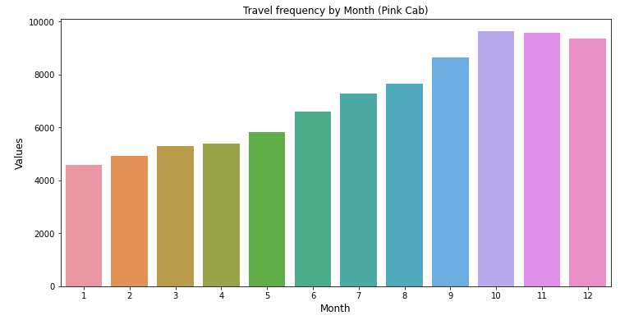
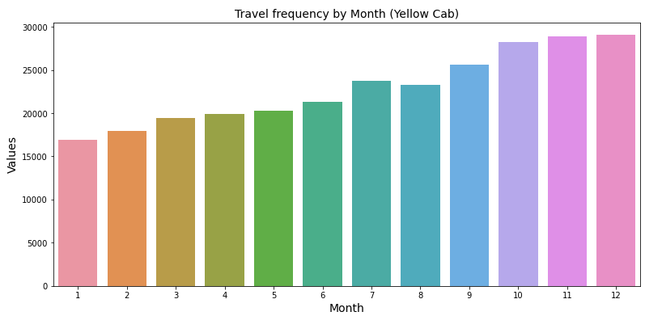
Monthly travel frequency
Yellow Cab has higher travel frequency (~29000) in the month of December which is the holiday season compared to Pink Cab (~9000)

Slide 16
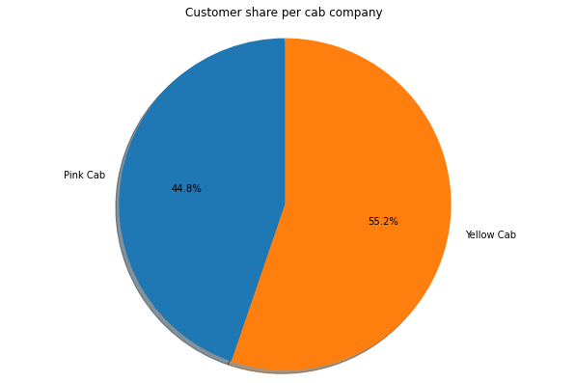
Customer Share per cab company
Yellow Cab has a higher customer base(55%) than Pink Cab(45%)

Slide 17
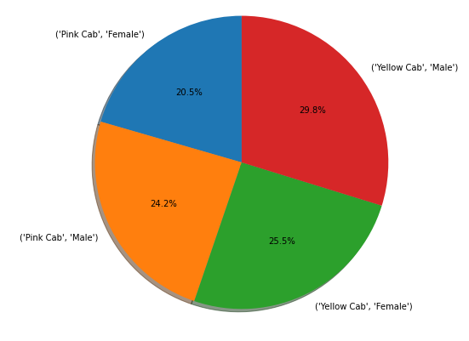
Customer share per cab gender-wise
Female Customers in Yellow Cab is higher compared to Female customers in Pink Cab
Male Customers in Yellow Cab is the highest

Slide 18
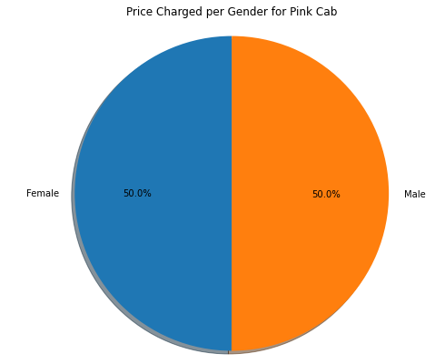
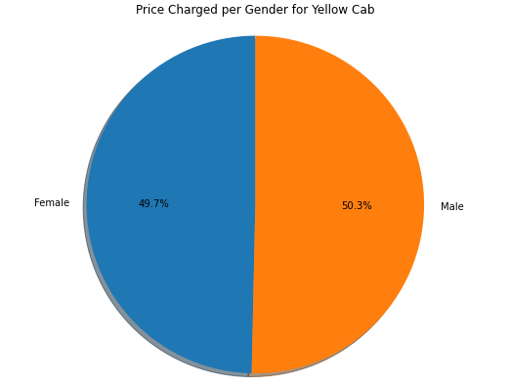
Price Charged per Gender for each Cab
Pink Cab charges same for both Male and Female Customers
Yellow Cab charges slightly less from its Female Customers

Slide 19
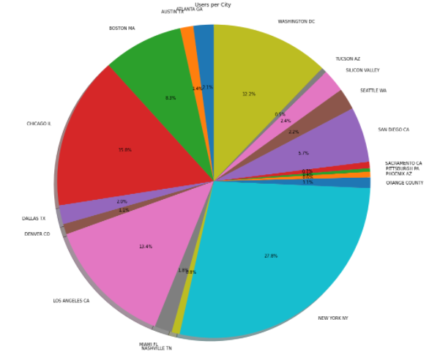
New York City has the highest Cab users(28%) followed by Chicago(16%)

Slide 20
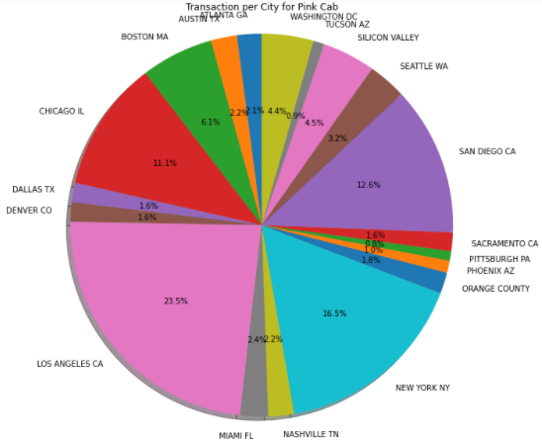
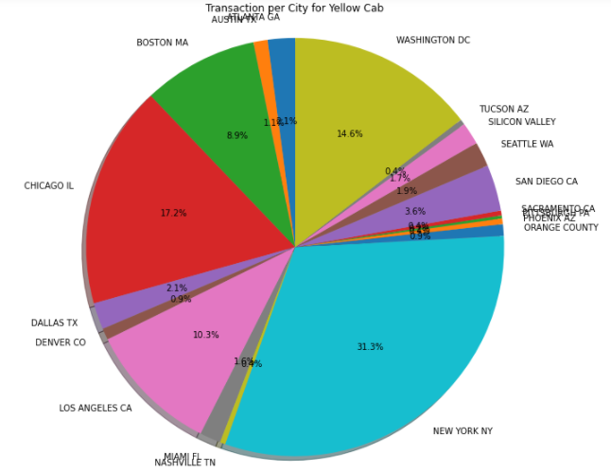
Transaction per City for each Cab
Transaction for Pink Cab is highest in Los Angeles City(23.5%) followed by New York City(16%)
Transaction for Yellow Cab is highest in New York City(31%)

Slide 21
Hypothesis Test
Does margin differ gender-wise for both Yellow Cab & Pink Cab?
Is there a margin difference age-wise for both Yellow Cab & Pink Cab?
Is there a margin difference for different modes of payment?

Slide 22


Test 1- Margin remains same gender-wise
Pink Cab - There is no difference in margin between male and female customers
Yellow Cab - There is a difference in margin between male and female customers

Slide 23


Test 2- Margin remains same across all age groups
Pink Cab - There is no difference in margin for all the age groups
Yellow Cab - There is a difference in margin for people older than 50 years

Slide 24


Test 3 - Margin is same for different modes of payment
Pink Cab - There is no difference in margin for different modes of payments
Yellow Cab - There is no difference in margin for different modes of payments

Slide 25
Analysis Summary
Yearly average profit margin for Yellow cabs is higher than 120 USD whereas for Pink Cabs it is below 100 USD
Higher price charged by Yellow cabs generating surplus profit each year compared to profits generated by Pink Cabs
Price charged by Yellow cabs for female users is slightly less
Pink cabs generated higher profits with increase in transactions whereas Yellow cabs the profits decrease with increase in transactions - could be due to discounts given by Yellow cabs to older age groups and female users and repeat customers to retain them
Yearly transactions for Yellow cabs is higher than Pink Cabs
Yellow cabs charges a higher price for New York City users - due to high number of users(28%)
Yellow cabs has higher monthly travel frequency than Pink cabs
Customer Share for Yellow cabs is higher than Pink Cabs
Summarize the Exploratory Data Analysis with some reasonings

Slide 26
Insights & Recommendations
Yellow cabs yearly performance is commendable
Yellow cabs has the higher number of customers and strategically retains them without affecting the profit margins
Yellow cabs has captured a high range of users in New York City(profitable city due to large customer base)
Hypothesis tests shows a difference in margins generated gender-wise and age group for Yellow cabs without affecting their overall profitability pointing to customer centric business
All in all, we find Yellow cabs performing the best and we would recommend XYZ to invest in Yellow Cab company for higher return rates annually

Slide 27
Thank You

